Slide 1

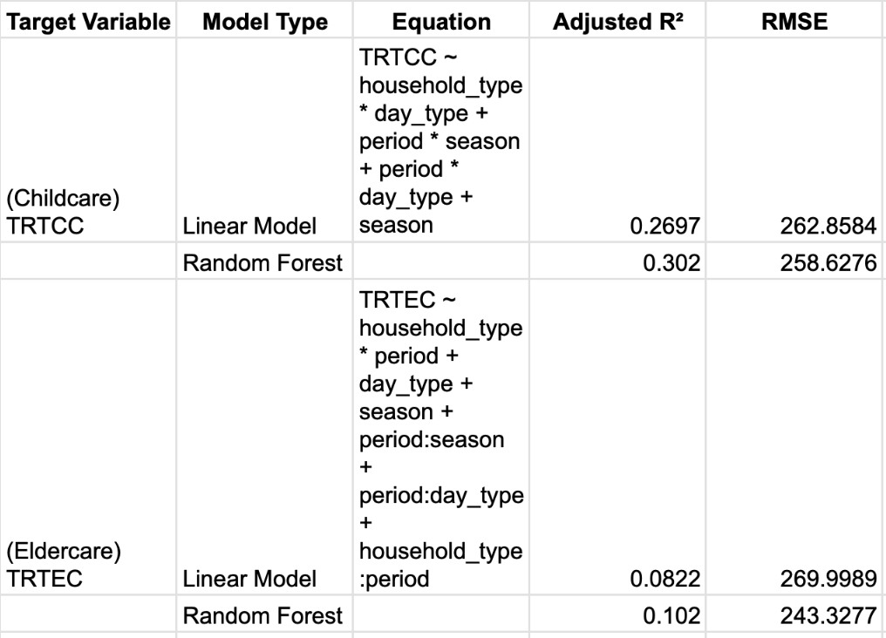
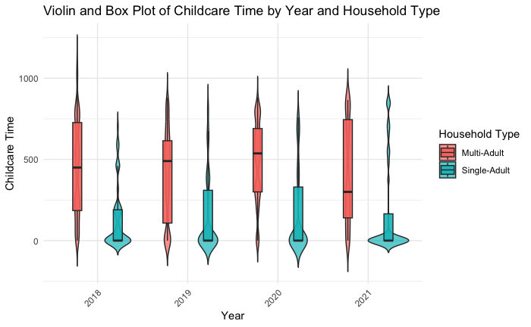
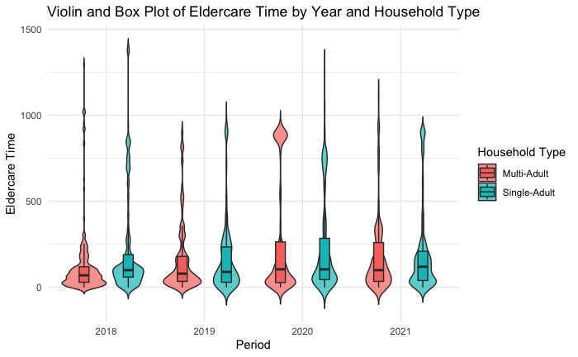
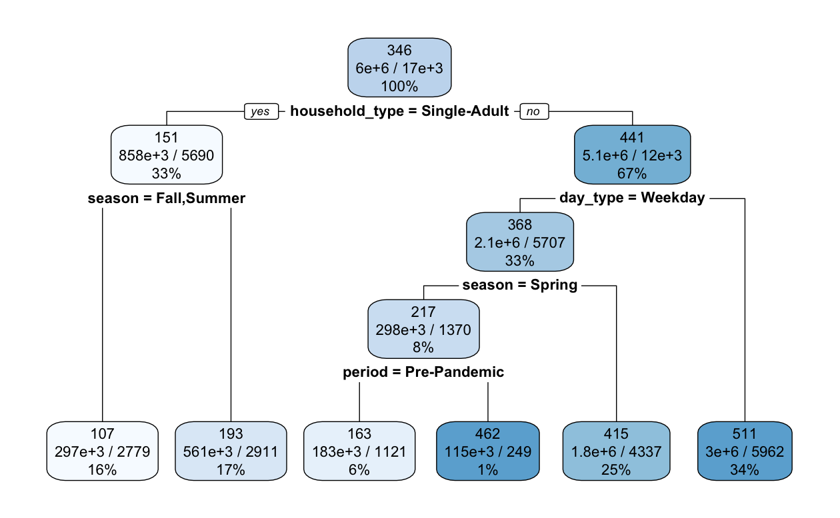
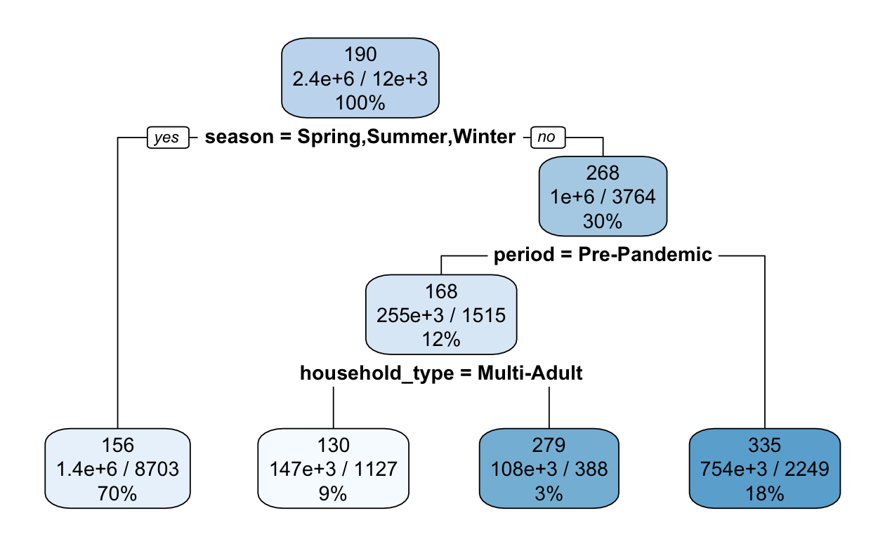
Shifting Caregiving Responsibilities: Analyzing Childcare and Eldercare Across Household Types Before and During the Pandemic
Nimo Mohamud | Class 2025 | Data Science Capstone
Research Question:
How did total caregiving time (childcare and eldercare), including households reporting zero caregiving time, vary by household type before and during the pandemic?"
Introduction
Methodology
Results
While COVID-19 changed daily routines for many, it greatly increased the caregiving load on households, with 30.5% of caregivers reporting more responsibilities during the pandemic (Leggett, Koo, Park, Choi *). This project explores changes in caregiving patterns before and during the pandemic, as well as how household composition influenced caregiving time allocations.
Childcare
Eldercare
Model Findings:
Random forest models outperformed linear models for both caregiving times
The childcare random forest model explains more variation in childcare time compared to the eldercare model,
Variable Importance:
For childcare, most important predictors were household_type and day_type.
For eldercare:season and period.
Data Prepartion
Data was sourced from American Time Use Survey using the respondent, activity, roster, and eldercare files, and combined to analyze caregiving patterns during pre-pandemic years (2018–2019) and pandemic years (2020–2021).
Single-adult households: No spouse/partner, at least two members, with children under 13 or an elder.
Multi-adult households: At least three members, including a spouse/partner, with children under 13 or an elder
Pre-Pandemic (2018–2019):
Higher childcare time overall for multi-adult households
Pandemic (2020-2021):
Multi-adult: Increased caregiving time during the pandemic, especially in 2020. Wide distribution
Single-adult: Consistently low childcare time
Decision Tree
HH is determinant for childcare giving time
Childcare time is higher on weekends compared to weekdays.
Childcare time is higher in the Spring and winter for single-adult households
Pre-Pandemic Period (2018–2019):
Single adult households reported higher median eldercare time
During Fall, the pandemic led to a noticeable increase in eldercare time (18% vs. 12% pre-pandemic).
Pandemic
median ws consistent, more variability in 2020 for both households
Decision Tree
Eldercare time is higher during spring, summer, and winter
Pandemic years are associated with lower eldercare time
Conclusion
Childcare
Multi-adult households spent more time on childcare than single-adult households in both periods, but during the pandemic, the time spent became more uneven
Eldercare
single-adult households provided more care before the pandemic, especially on weekends and in non-winter seasons, while multi-adult households took on more eldercare during the pandemic, particularly in Fall.

